Slide 1
2. Logical Design
Relational Model

Slide 2
Conversion
ER into Relational Schema
We need to follow some set of rules to achieve this.
Step 1: Mapping of Regular/Strong Entity Types
Step 2: Mapping of Weak Entity Types
Step 3: Mapping of Binary 1:1 Relation Types
Step 4: Mapping of Binary 1:N Relationship Types.
Step 5: Mapping of Binary M:N Relationship Types.
Step 6: Mapping of Multivalued attributes.
Step 7: Mapping of N-ary Relationship Types.

Slide 3
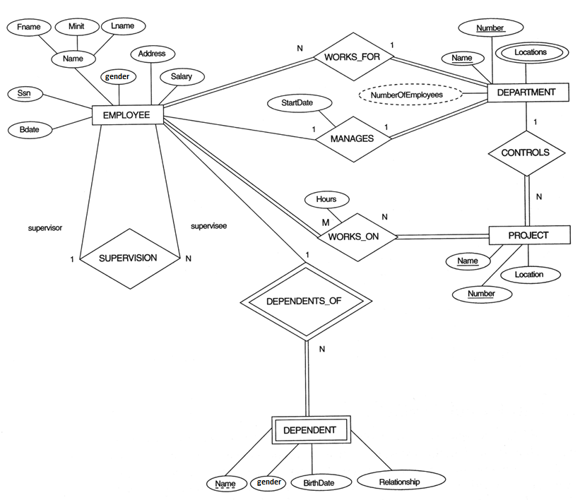

Slide 4
Step 1. Convert strong entity

Slide 5
Step 2. Convert weak entity

Slide 6
Step 3. Convert 1:1 relationship

Slide 7
Step 4 Convert 1:N relationship

Slide 8
Step 5 Convert M:N relationship

Slide 9
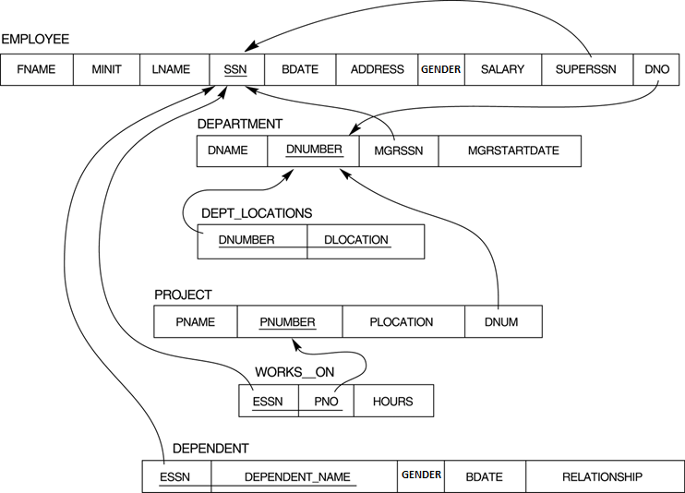
Resultant Logical Schema

Slide 10
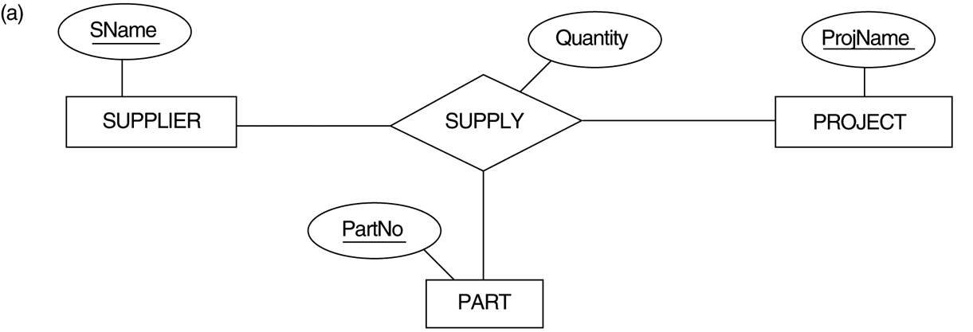
Ternary relationship types. (a) The SUPPLY relationship.

Slide 11
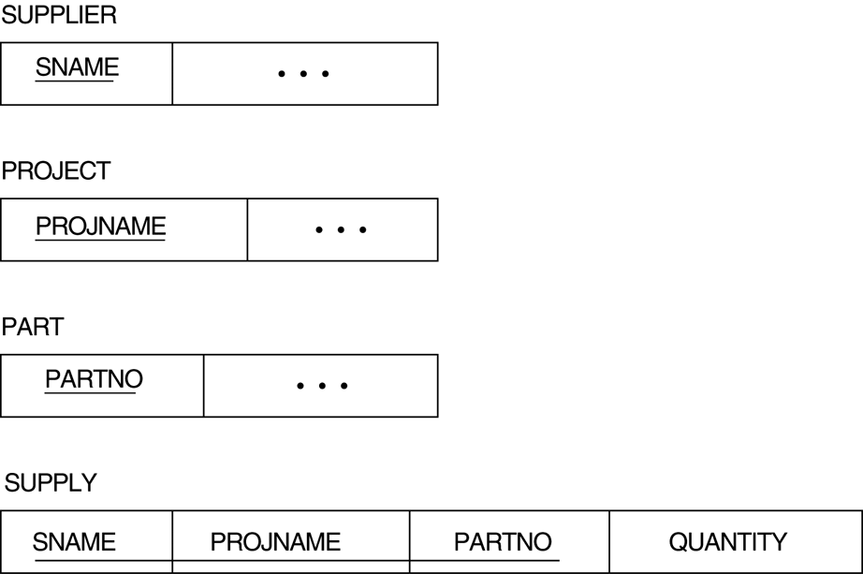
FIGURE 7.3 Mapping the n-ary relationship type SUPPLY from Figure 4.11a.

Slide 12
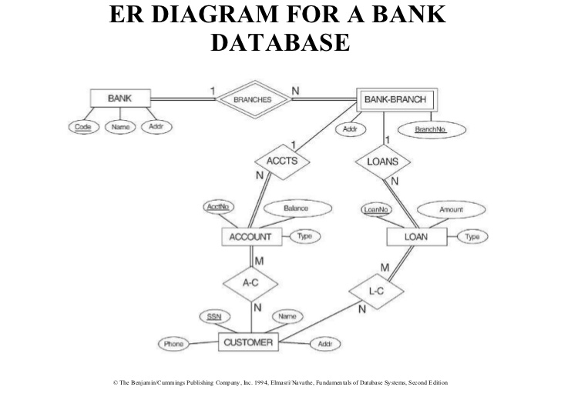
Class activity
Branches show that this is an identifying relationship

Slide 13
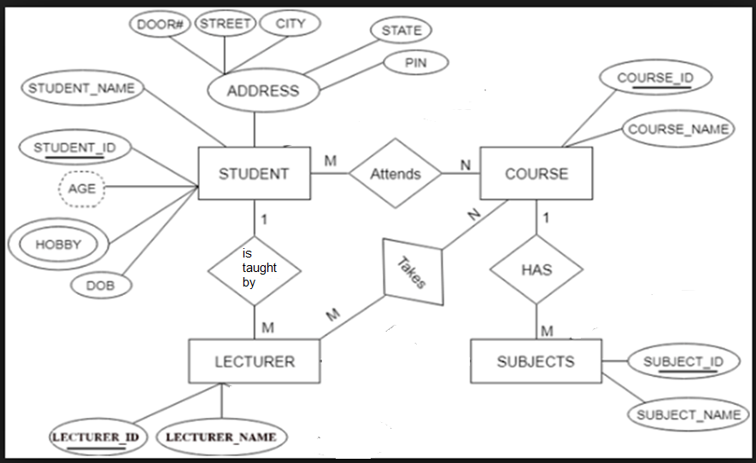
Class Activity 2

Slide 14
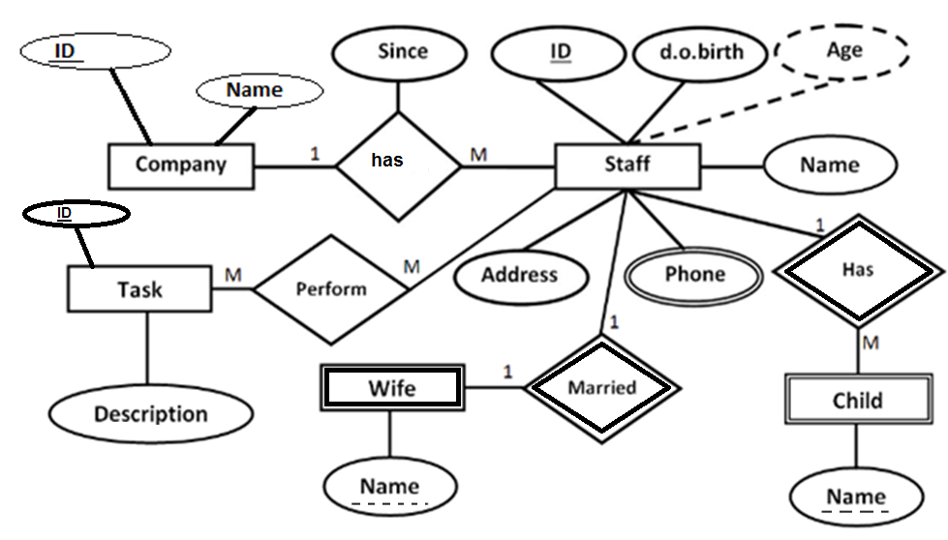
Class Activity 3
Weak relationship over here
Staff and child
Child needs staff ki foreign key
For it’s identification.
Weak relationship between staff and married
Married cannot exist on it’s own , it needs staff
Ki foreign key for it’s identification.

Slide 15
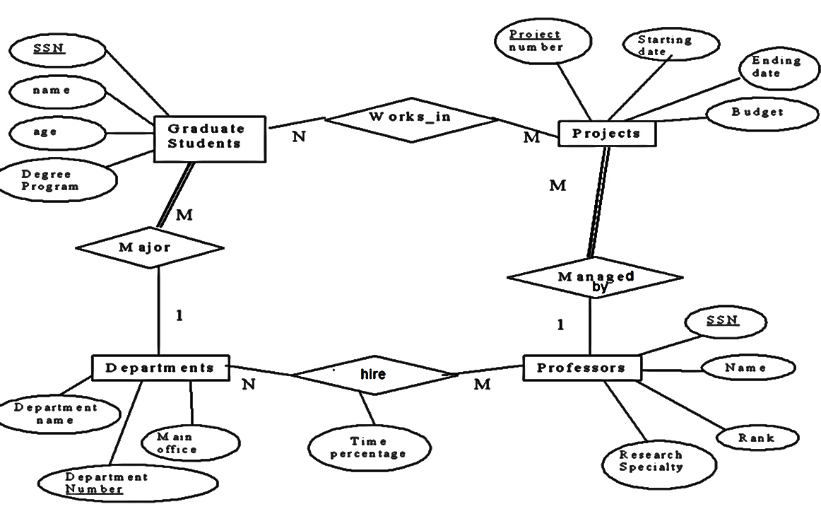
Class Activity 4

